Slide 1
Data Science 100 Final Review (Part 2)
?
Slides by:
Joseph E. Gonzalez & Deb Nolan,
jegonzal@berkeley.edu
deborah_nolan@berkeley.edu
Sp18 updates: Fernando Perez fernando.perez@Berkeley.edu

Slide 2
Expectations and Variance of Random Variables

Slide 3
The Expected Value
Computing expectations:
Linearity of expectation [independence not required]
x | Pr(X = x)
0 | 0.2
1 | 0.3
2 | 0.5
Note X can never be 1.3

Slide 4
The Variance
Useful Identity:
Expanding the square

Slide 5
The Variance
Useful Identity:
Expanding the square
constant
Linearity of expectation
constant
Linearity of expectation
Algebra

Slide 6
The Variance
Properties of Variance:
If X and Y are independent:

Slide 7
The Variance
Properties of Variance:
If X and Y are independent:
Standard Deviation (easier to interpret units)
Useful identity

Slide 8
0,1 Random Variable (Bernoulli)
Takes on two values (e.g., (0,1), (heads, tails)…)
Characterized by probability p
Expected Value:
Variance
Value | 1 | 0
Chance | p | 1-p

Slide 9
Sample Mean is a Random Variable
Expected Value:
Linearity of expectation

Slide 10
Sample Mean is a Random Variable
Expected Value:
Linearity of expectation
Let 𝜇 be the expected value for all X_{i}

Slide 11
Sample Mean is a Random Variable
Expected Value:
Variance:

Slide 12
Sample Mean is a Random Variable
Expected Value:
Variance:
Assuming X_{i} are independent
Let σ² be the variance for each X_{i}
Algebra

Slide 13
Sample Mean is a Random Variable
Expected Value:
Variance:
Assuming X_{i} are independent

Slide 14
Sample Mean is a Random Variable
Expected Value:
Variance:
Assuming X_{i} are independent
Standard Error:
Square root law

Slide 15
Bias and Variance of Sample Mean
Expected Value:
Variance:
Assuming X_{i} are independent
Is the sample mean biased?
No
How fast does the variance decrease with more data?
1/n
Notes:
The sample mean is an unbiased estimator of the population mean – it assumes all the Xi are drawn from a single population, whose mean is \mu.

Slide 16
Least Squares Linear
Last Week:
Regression

Slide 17
Kleiber’s Equation and the Spherical Cat
Does a horse produce more heat per day per kilogram of body mass than a rat?
Explanatory Variable (X)
Mass in kilograms
Response (Y)
Metabolic rate: kilocalories per day
Linear model (transformed):
Minimize Squared Loss:
a
b

Slide 18
Formulas for the minimizing values:
Regression line:
Slope:
Intercept:
Sample Correlation:

Slide 19
Example Correlations for data with positive linear association (SDs = 1)
What would negative correlation look like?

Slide 20
Recalling Notation
Modeling the relationship between X and Y
Covariate (Design) Matrix
Response Vector
n
n
Records
p
1
n records in p dimensions (columns or features)

Slide 21
The Linear Regression Model
p
Parameters
1
p
Record
=
1
1
1
Foundation of many machine learning and statistical methods.

Slide 22
Model Estimation Goal
Find a model that minimizes the squared error
How do we minimize the loss?

Slide 23
Geometric Approach
Examine the column spaces:
Columns space of X
n
n
p
1
Linear model → Y is a linear combination of columns X
p
=
1
Ŷ is in the subspace spanned by the columns of X
Y
Definition of orthogonal
(Y – Xθ)
Subspace spanned by X¹ and X²
X¹
Normal to subspace
Spanned by X
Xθ
Normal
Equations
X²

Slide 24
Vector Calculus and Least Squares Linear Reg.

Slide 25
Take the derivative (now gradient) of the loss:
Taking the gradient with respect to θ
Notes:
Why 2ytXtheta? It’s a scalar!!

Slide 26
Take the derivative (now gradient) of the loss:
Taking the gradient with respect to θ
Set equal to zero and solve for θ
Normal Equations

Slide 27
Matrix Calculus
You should know:
We will not ask complex matrix calculus questions
We may ask you to compute gradient with respect to 1 dimension

Slide 28
Adding a Bias (Intercept)
Notice the above equation is missing an intercept term
Solution: Add an extra feature dimension
bias or intercept term
n
n
1
1
Feature
transformation
1
p
p+1

Slide 29
Feature Engineering

Slide 30
Recap:
Feature Engineering
Linear models with feature functions:
Feature Functions:
Domain

Slide 31
One Hot Encoding (dummy encoding)
Transform categorical feature into many binary features:
One-hot-encoding: multiple “wires” for possible values one is hot …
state
NY
WA
CA
AL | … | CA | … | NY | … | WA | … | WY
0 | … | 0 | … | 1 | … | 0 | … | 0
0 | … | 0 | … | 0 | … | 1 | … | 0
0 | … | 1 | … | 0 | … | 0 | … | 0
Cat
Dog
Fish

Slide 32
Adding Dummy variables to a model yields parallel fitted lines
Group 1
Group 2
Group 3

Slide 33
One-hot encoding: Categorical Data
Bag-of-words & N-gram: Text Data
Custom Features: Domain Knowledge

Slide 34
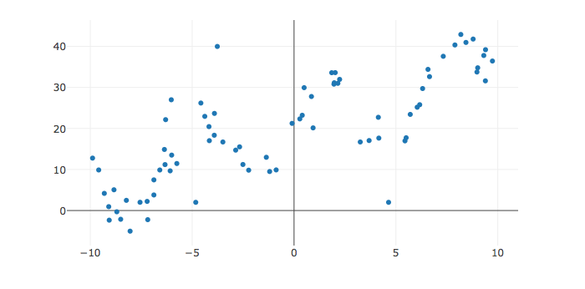
Introducing Non-linear Feature Functions
In our toy dataset there appears to be cyclic patterns
One reasonable feature function might be:
Introducing hyper-parameters that are externally optimized (e.g., trying a range of values …)
Hyper-parameters

Slide 35
Choice Features and our Goal
Goal = Inference
Goal = Prediction
We are interested in the form of the model and the values of the parameters
Too many parameters → model is no longer uniquely defined
We are not interested in the parameter values
Doesn’t matter if model is not unique defined → any accurate model will suffice
Notes:
Inference: model interpretability, simplicity, meaning of the features are critical. Small models.
Prediction: model may not even have a meaning, but it matters that it works.

Slide 36
Overfitting, Cross Validation, and the Bias-Variance Tradeoff

Slide 37
Fundamental Challenges in Learning?
Fit the Data
Provide an explanation for what we observe
Generalize to the World
Predict the future
Explain the unobserved
Is this cat grumpy or are we overfitting to human faces?

Slide 38
Fundamental Challenges in Learning?
Bias: the expected deviation between the predicted value and the true value
Variance: two sources
Observation Variance: the variability of the random noise in the process we are trying to model.
Estimated Model Variance: the variability in the predicted value across different training datasets.

Slide 39
Bias
The expected deviation between the predicted value and the true value
Depends on both the:
choice of f
learning procedure
Under-fitting
All possible functions
Possible θ values
Bias
True Function

Slide 40
Observation Variance
the variability of the random noise in the process we are trying to model
measurement variability
stochasticity
missing information
Beyond our control (usually)

Slide 41
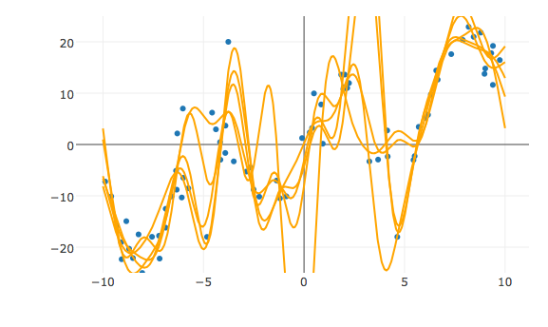
Estimated Model Variance
variability in the predicted value across different training datasets
Sensitivity to variation in the training data
Poor generalization
Overfitting

Slide 42
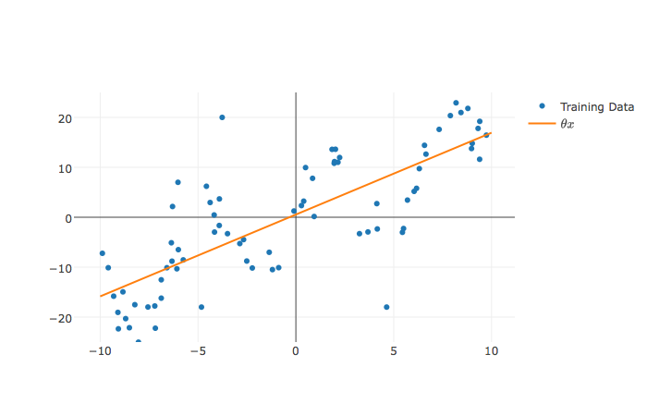
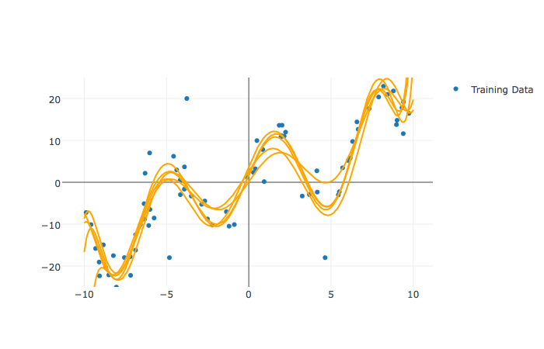
The Bias-Variance Tradeoff
Estimated Model Variance
Bias

Slide 43
Analysis of Squared Error
=
Obs. Var. +
(Bias)² +
Mod. Var.
Other terminology:
“Noise” +
(Bias)² +
Variance

Slide 44
=
Obs. Variance
“Noise”
(Bias)²
Model Variance
Know the decomposition. Understand key steps of derivation.

Slide 45
Training vs Test Error
← Underfitting
Overfitting →
Typically
Best Fit
Test Error
Training
Error
<
Test
Error
Error
Training Error
Why
Training minimizes training error
Model “complexity”
(e.g., number of features)

Slide 46
Train-Test Split & Cross Validation
Be able to explain everything on this slide!
V
Train - Test
Split
Validation
Split
Train
Train
V
Train
Train
V
Train
Data
V
Train
Validate Generalization
V
5-Fold
Cross Validation
Test
Cross validation simulates multiple train test-splits on the training data.
You can only use the test dataset once after deciding on the model.

Slide 47
Regularization Parametrically Controlling the Model Complexity
𝜆
Tradeoff:
Increase bias
Decrease variance

Slide 48
Basic Idea of Regularization
Penalize
Complex Models
Fit the Data
Regularization Parameter
How should we define R(θ)?
How do we determine 𝜆?

Slide 49
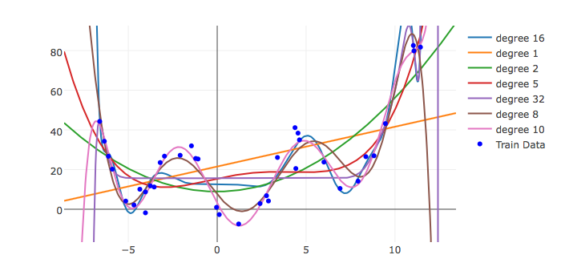
The Regularization Function R(θ)
Goal: Penalize model complexity
Recall earlier:
More features → overfitting …
How can we control overfitting through θ
Proposal: set weights = 0 to remove features

Slide 50
Common Regularization Functions
Ridge Regression (L2-Reg)
LASSO
(L1-Reg)
Distributes weight across related features (robust)
Analytic solution (easy to compute)
Does not encourage sparsity → small but non-zero weights.
Encourages sparsity by setting weights = 0
Used to select informative features
Does not have an analytic solution → numerical methods
Notes:
Least Absolute Shrinkage and Selection Operator

Slide 51
Regularization and Norm Balls
Loss
Loss
Loss
𝜃₂
𝜃₂
𝜃_{opt}
𝜃₂
𝜃_{opt}
𝜃_{opt}
Snaps to
corners
Snaps to
corners
𝜃₁
𝜃₁
𝜃₁
Robust weight
sharing
Sparsity
inducing
Compromise…
Two parameters …
L2 Norm (Ridge)
L1 Norm (LASSO)
L1 + L2 Norm
(Elastic Net)

Slide 53
Standardization and the Intercept Term
Height = θ₁ age_in_seconds + θ₂ weight_in_tons
Regularization penalized dimensions equally
Standardization
Ensure that each dimensions has the same scale
centered around zero
Intercept Terms
Don’t regularize intercept term ← Suggested
Center y values (e.g., subtract mean)
Small
Large
Standardization
For each dimension k:

Slide 54
Determining the Optimal 𝜆
Value of 𝜆 determines bias-variance tradeoff
Larger values → more regularization → more bias → less variance

Slide 55
Determining the Optimal 𝜆
Test Error
Optimal Value
Validation Error
(Bias)²
Error
How do we determine 𝜆?
Variance
Increasing 𝜆
Value of 𝜆 determines bias-variance tradeoff
Larger values → more regularization → more bias → less variance
Determined through cross validation

Slide 56
Classification

Slide 57
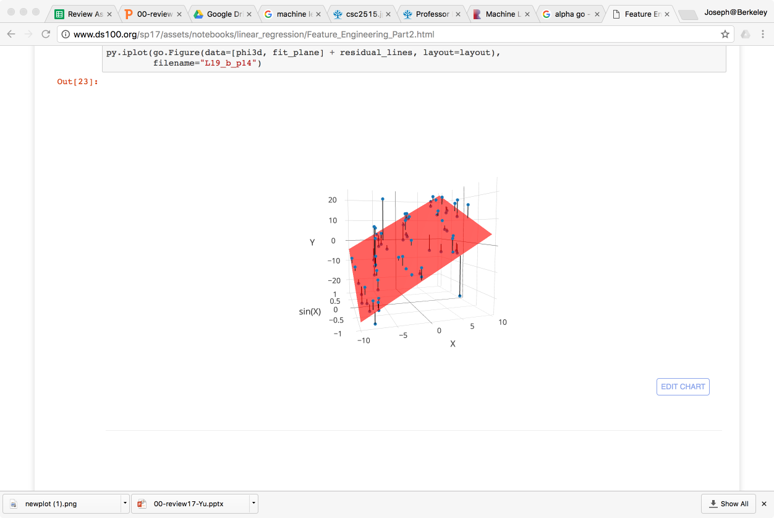
Taxonomy of Machine Learning
Labeled Data
Unlabeled Data
Supervised Learning
Reinforcement
Learning
(not covered)
Unsupervised
Learning
Continuous Response
Categorical Response
Dimensionality Reduction
Clustering
Regression
Classification
Alpha Go

Slide 58
Feature Engineering
Regression
Sales
Domain
Classification
Document,
Record,
Pictures,
…
isCat? {0, 1}
Supervised Learning
Given pairs of (Features, Label) learn a function from feature → label
Continuous Label → Regression
Categorical Label → Classification

Slide 59
Zero-One Loss
What would your loss be?
Remember that in the study, 72% were alive in 20 years
So we are correct 72% of the time and incorrect 28% of the time (for these data)
This is the simplest baseline we could imagine and one you should always compare against. It's the majority class

Slide 60
Class Imbalance
Class imbalance is when a disproportionate fraction of the samples are in one class (in this case alive).
In extreme cases (e.g., fraud detection) only tiny fraction of the training data may contain examples in particular class. In these settings we can achieve very high-accuracies by always predicting the frequent class without learning a good classifier for the rare classes.

Slide 61
Error Rates
We often do not simply want to report the overall error rate, but instead report the error rate for the true 0s and the true 1s separately
Sensitivity – true positive rate is the proportion of positives that are correctly predicted (Error is Type I)
Specificity - true negative rate is the proportion of negatives that are correctly predicted (Error is Type II)

Slide 62
Confusion Matrix
 |  | Prediction
 |  | FALSE | TRUE
Truth | FALSE | Specificity = n_{FF}/(n_{FF}+n_{FT}) | n_{FT}
 | TRUE | n_{TF} | Sensitivity = n_{TT}/(n_{TF}+n_{TT})

Slide 63
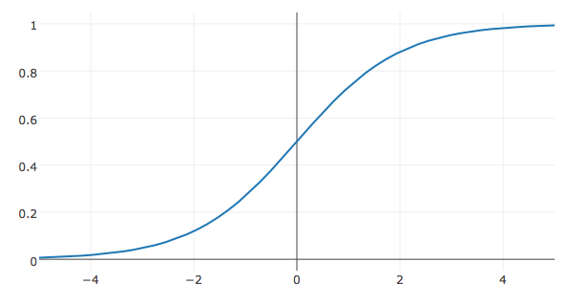
Logistic Regression
Model:

Slide 64
Logistic Function and the Log Odds
Logistic activation function implies → log odds:

Slide 65
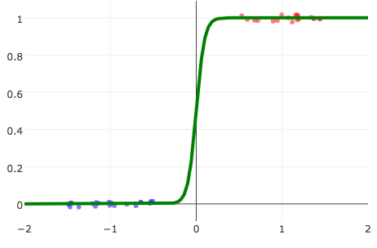
Linearly Separable Data
Linearly Separable Data
A classification dataset is said to be linearly separable if there exists a hyperplane that separates the two classes.
If data is linearly separable, logistic regression requires regularization
Not Linearly Separable Data
Weights go to infinity!

Slide 66
Loss Function
We want our model to be close to the data:
Kullback–Leibler (KL) Divergence
For a single (x,y) data point
Average KL Divergence for all the data:
=2
Binary Classification

Slide 67
Loss Function
We want our model to be close to the data:
Kullback–Leibler (KL) Divergence
For a single (x,y) data point
Average KL Divergence for all the data:
=2
Binary Classification
Log(a/b) = Log(a) – Log(b)
Doesn’t depend on θ

Slide 68
Loss Function
We want our model to be close to the data:
Kullback–Leibler (KL) Divergence
For a single (x,y) data point
Average KL Divergence for all the data:
=2
Binary Classification
Minimize average cross entropy loss
Notes:
\arg \min_\theta \frac{1}{n}
\sum_{i=1}^n \sum_{k=1}^K

Slide 69
The Loss for Logistic Regression
Average cross entropy (simplified):
Equivalent to (derived from) minimizing the KL divergence
Also equivalent to maximizing the log-likelihood of the data … (not covered in DS100 this semester)

Slide 70
Logistic Loss Function
Average cross entropy (simplified)
Take Derivative:
No general analytic solution
Solved using numeric methods
Gradient descent – a general optimization algorithm

Slide 71
Gradient Descent Intuition
L(θ)
Loss
-gradient
How far should we go?
Gradient = 0
Simple, fast, and works well in high dimensions.

Slide 72
initial vector (random, zeros …)
For 𝜏 from 0 to convergence:
Gradient Descent
Very Similar Algorithms
initial vector (random, zeros …)
Assuming Decomposable Loss Functions
For 𝜏 from 0 to convergence:
Stochastic Gradient Descent

Slide 73
Multiclass (more than 2) Classification
One-vs-rest train separate binary classifiers for each class
Class with highest confidence wins
Need to address class imbalance issue
Soft-Max multiclass classification

Slide 74
Monte Carlo Sampling & the Bootstrap

Slide 75
has a probability mass function
ALSO KNOW AS A
SAMPLING DISTRIBUTION

Slide 76
The Distribution of an Estimator
Resampling the population to estimate the sample distribution.
Population
Variability in my estimation procedure.
Sample 1
Sample 2
Sample 3
Confidence
Interval
7.6 Billion People

Slide 77
Central Limit Theorem
Describes the limiting shape of the distribution of the sample average
The sample average behaves approximately like a random draw from the normal distribution
Assumes independent and identically distributed observations

Slide 78
Law of Large Numbers
Relationship between sample mean and the population mean.
As the sample size grows the sample average approaches the population average.

Slide 79
Bootstrap the Distribution of an Estimator
Simulation method to estimate the sample distribution.
Pretend this is your population!
Population
Bootstrap Samples
Variability in my estimation procedure.
Sample
Sample with replacement
Confidence
Interval
7.6 Billion People

Slide 80
Bootstrap the Distribution of an Estimator
Simulation method to estimate the sample distribution.
Pretend this is your population!
Population
Bootstrap Samples
Variability in my estimation procedure.
Sample
Sample with replacement
Confidence
Interval
7.6 Billion People

Slide 81
Boot Strap Confidence Interval
Construct a 95% confidence interval by taking the 2.5% and (100 - 2.5)% quantiles:
95%
2.5%
2.5%

Slide 82
Studentized Bootstrap Confidence Interval
Population
Standarized statistic
Sample
Sample statistic
7.6 Billion People
Population statistic
(you don’t know this)
Compute these using bootstrap

Slide 83
Studentized Bootstrap Confidence Interval
Sample statistic
Compute these using bootstrap
Standarized statistic
Population
Sample
Bootstrap Samples
7.6 Billion People
Population statistic
(you don’t know this)
95%
2.5%
2.5%

Slide 84
Studentized Bootstrap Confidence Interval
Sample statistic
Compute these using bootstrap
We know how to compute this for some estimators:
Example: mean
Standarized statistic
Population
Sample
Bootstrap Samples
7.6 Billion People
Population statistic
(you don’t know this)
95%
2.5%
2.5%

Slide 85
Hypothesis Testing

Slide 86
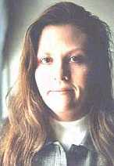
1. United States v. Kristen Gilbert
(from Cobb and Gehlbach, “Statistics in the Courtroom”, in Statistics: A Guide to the Unknown)

Slide 87
Suspicions
By the mid 1990’s, other nurses had become suspicious
Too many code blue calls, too many crises when Gilbert was on the ward.
An initial VA report found that the number of deaths were consistent with patterns at other VA hospitals.
Why might this be?
Hired a statistician to look into the situation …

Slide 88
QUESTION: Were there so many excess deaths when Gilbert was present as to be suspicious in the eyes of science?

Slide 89
A Table of Counts
40
1641
217
1641
P(Gil., Death) =
= 0.0244
P(Gil., Life) =
= 0.1322
34
1641
1350
1641
P(no Gil., Death) =
= 0.0207
P(no Gil., Life) =
= 0.8227

Slide 90
A Table of Counts
40
1641
217
1641
P(Gil., Death) =
= 0.0244
P(Gil., Life) =
= 0.1322
34
1641
1350
1641
P(no Gil., Death) =
= 0.0207
P(no Gil., Life) =
= 0.8227
257
1641
40
257
P(Gil.) =
= 0.1566
P(Death | Gil.) =
= 0.1556
74
1641
34
1384
P(Death) =
= 0.0451
P(Death | no Gil.) =
= 0.0246

Slide 91
QUESTION: Was she just unlucky?

Slide 92
Hypothesis Testing
Null Model: Probability model for explaining the chance process for generating the data
Test Statistic: summary of data, under the null model it has a sampling distribution
Null Hypothesis: What is expected is due to chance variability described by the null model.
Alternative Hypothesis: The alternative to the null hypothesis. This may be a simple as “The difference is real”.
p-value: Chance of an outcome at least as rare as the one observed, under the assumptions of the null model.

Slide 93
Hypothesis Testing
(Alternative) Hypothesis:
The number of deaths on a shift depends on whether Gilbert is present
Null Hypothesis:
The number of deaths is independent of whether Gilbert is present
Null Model: P(Death | Gil.) = P(Death)
Sample 257 shifts from P(Death) to simulate Gilbert’s shifts from the null hypothesis.
Test Statistic:
Number of deaths on each shift

Slide 94
P(at least 40) < 1 in a trillion
Population with 1641 records.
74 have the value 1 (death)
1567 are 0.
Sample 257 times, to create Gilbert’s shifts.
The sum is the number of deaths on Gilbert’s shift.
Area under the curve

Slide 95
Hypothesis Test
Assume Gilbert’s presence and death on a shift are independent
Under this model for generating the data, what is the chance we would see an outcome as extreme as the one that we saw?
The chance is so rare that we reject the model of independence.

Slide 96
T/F Statements
The chance is less than 1 in a trillion that Gilbert is innocent.
False! → Prosecutors Fallacy
We calculated: the probability of seeing 40 or more deaths assuming the chance of death is independent of her presence
Independence is a … proxy for innocence
Prosecutors Fallacy: small probability that she is innocent
Gilbert was not assigned to her shifts at random so this probability calculation is flawed
False! → We assumed independence and then tested if we had made those assumptions if we would have seen this data.
The probability is so small that we’re sure Gilbert’s shifts are not independent of whether or not there was a death, but that doesn’t prove she’s guilty. There could be other explanations.
True → We have evidence to reject the null hypothesis

Slide 97
P-Hacking
One of the kinds of hacking that’s not cool

Slide 98
The first principle is that you must not fool yourself, and you are the easiest person too fool.
Richard Feynman
1918-1988

Slide 99
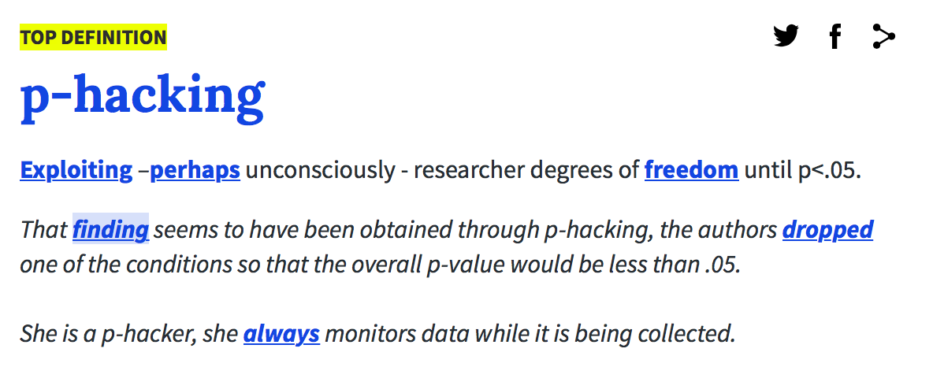
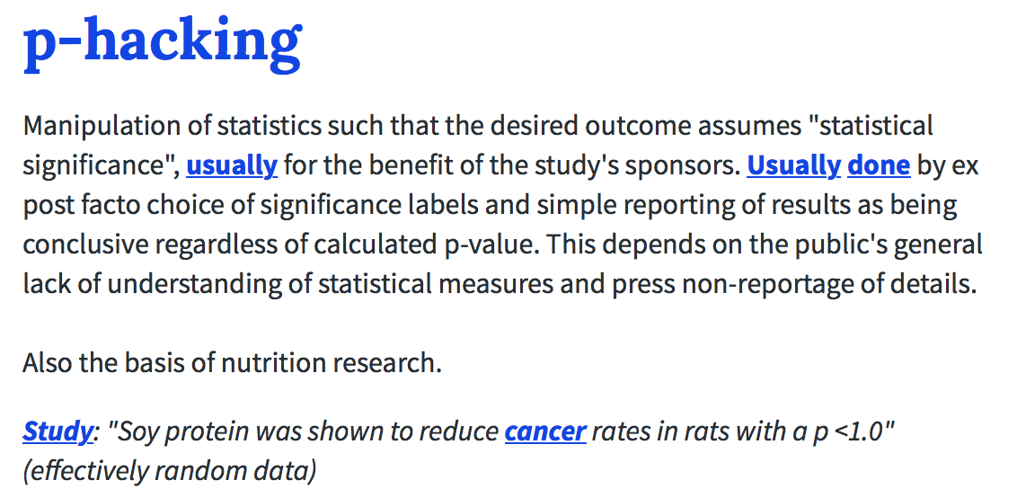
P-Hacking according to the Urban Dictionary
This is sometimes disputed

Slide 100
How to fool yourself
Selection bias and the Texas sharpshooter fallacy
Picking the data to support the hypothesis
Picking the hypothesis and testing on the same data
Sampling Bias:
failing to reflect “representative” data
Confirmation Bias:
Tendency to search for or interpret data and patterns in a way that supports the hypothesis instead of trying to disprove the hypothesis.
Post hoc ergo procter hoc: after this, therefore because of this
Inferring causal relationships from sequences of unrelated events
..

Slide 101
More ways to fool you
Simpson’s Paradox
When an overall trend in data vanishes or even reversed when examined in sub-groups
Gambler’s Fallacy (Type 1 and Type 2)
Past independent events have an effect on future outcomes
Type 1: Reversion to the mean: HHHHHHH … next flip must be tails
Type 2: Overconfident of bias: HHHHHHH … coin must be biased!
Multiple Testing … (next slide)

Slide 102
Multiple Hypothesis Testing

Slide 103
Multiple Hypothesis Testing
+1
-1
-1
+1
-1
+1
+1
-1
+1
= sum of flips (+1 + -1 + -1 + +1 + … )
Fix sample size to N then coin is likely biased if
Check at every flip n:
Don’t need to know equation or derivation.
However be aware of need for correction
Common mistake in A/B testing.
Run trial until significant …

Slide 104
Big

Slide 105
Sales
(Asia)
Data Warehouse
ETL
Collects and organizes historical data from multiple sources
Sales
(US)
ETL
ETL
Inventory
Data is periodically ETLed into the data warehouse:
Extracted from remote sources
Transformed to standard schemas
Loaded into the (typically) relational (SQL) data system
ETL
Advertising

Slide 106
The Star Schema
← This looks like a star …
For more details, read P. Gonzalez’s Piazza post:
https://piazza.com/class/jc04z4cze297dy?cid=1190

Slide 107
Multidimensional Data Model
Sales Fact Table
Locations
pid | timeid | locid | sales
11 | 1 | 1 | 25
11 | 2 | 1 | 8
11 | 3 | 1 | 15
12 | 1 | 1 | 30
12 | 2 | 1 | 20
12 | 3 | 1 | 50
12 | 1 | 1 | 8
13 | 2 | 1 | 10
13 | 3 | 1 | 10
11 | 1 | 2 | 35
11 | 2 | 2 | 22
11 | 3 | 2 | 10
12 | 1 | 2 | 26
12 | 2 | 2 | 45
12 | 3 | 2 | 20
13 | 1 | 2 | 20
13 | 2 | 2 | 40
13 | 3 | 2 | 5
locid | city | state | country
1 | Omaha | Nebraska | USA
2 | Seoul |  | Korea
5 | Richmond | Virginia | USA
Dimension
Tables
Products
Multidimensional “Cube” of data
pid | pname | category | price
11 | Corn | Food | 25
12 | Galaxy 1 | Phones | 18
13 | Peanuts | Food | 2
Location Id
8
10
10
1
2
5
8
10
10
8
30
20
50
10
10
Time
13
30
20
50
30
25
8
15
20
50
timeid | Date | Day
1 | 3/30/16 | Wed.
2 | 3/31/16 | Thu.
3 | 4/1/16 | Fri.
Product Id
25
8
15
12
25
8
15
11
1
2
3
Time Id

Slide 108
Which schema illustration would best organize this data?
Data(calid, student_name, year,
major, major_grade_req,
asg1_name, asg1_pts, asg1_score, asg1_grader_name
asg2_name, asg2_pts, asg2_score, asg2_grader_name
avg_grade)
Grades(calid, asg_name, grader_id, score)
Graders(grader_id, grader_name)
Student(calid, name, year, major_id, avg_grade)
Majors(major_id, name, major_grade_req)
Assignments(asg_name, asg_pts)
Grades
Students
Students
Majors
Graders
Graders
Graders
Grades
Grades
(A)
(B)
Students
(C)
Majors
Assignments
Assignments

Slide 109

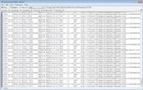

Data Warehouse
Sales
(Asia)
Data Lake
*
How do we clean and organize this data?
Sales
(US)
ETL
Store a copy of all the data
in one place
in its original “natural” form
Enable data consumers to choose how to transform and use data.
Schema on Read
ETL
Inventory
Depends on use …
ETL
Advertising
ETL
ETL ?
How do we load and process this data in a relation system?
Text/Log Data
Enabled by new Tools: Map-Reduce & Distributed Filesystems
Depends on use …
Can be difficult ...
Requires thought ...
Photos & Videos
What could go wrong?
It is Terrible!
*Still being defined…[Buzzword Disclaimer]

Slide 110
How do we store and compute on large unstructured datasets
Requirements:
Handle very large files spanning multiple computers
Use cheap commodity devices that fail frequently
Distributed data processing quickly and easily
Solutions:
Distributed file systems → spread data over multiple machines
Assume machine failure is common → redundancy
Distributed computing → load and process files on multiple machine concurrently
Assume machine failure is common → redundancy
Functional programming computational pattern → parallelism
Partition files/data to enable parallel loading and processing

Slide 111
Fault Tolerant Distributed File Systems (e.g., HDFS)
A
A
A
Big File
B
B
B
Split the file into smaller parts.
How?
Ideally at record boundaries
What if records are big?
C
C
D
C
D
D
Machine1
Machine 2
Machine 3
Machine 4
[Ghemawat et al., SOSP’03]

Slide 112
Fault Tolerant Distributed File Systems (e.g., HDFS)
Big File
Understand how to deal with failures.
Machine1
Machine 2
Machine 3
Machine 4
B
C
A
B
A
C
A
B
D
C
D
D
[Ghemawat et al., SOSP’03]

Slide 113
The Map Reduce Abstraction
Key
Value
Key
Value
Map
Reduce
Record
Key
Value
Key
Value
Value
Example: Word-Count
Map(docRecord) {
for (word in docRecord) {
emit (word, 1)
}
}
Reduce(word, counts) {
emit (word, SUM(counts))
}
Key
Value
Map: Deterministic
Reduce: Commutative and Associative
[Dean & Ghemawat, OSDI’04]

Slide 114
Key properties of Map And Reduce
Deterministic Map: allows for re-execution on failure
If some computation is lost we can always re-compute
Issues with samples?
Commutative Reduce: allows for re-order of operations
Reduce(A,B) = Reduce(B,A)
Example (addition): A + B = B + A
Is floating point math commutative?
Associative Reduce: allows for regrouping of operations
Reduce(Reduce(A,B), C) = Reduce(A, Reduce(B,C))
Example (max): max(max(A,B), C) = max(A, max(B,C))
Is FP math associative? (A+B)+C =? A + (B+C)

Slide 115
Ethics and A/B testing
A little on final, lectures fresh in your mind …

Slide 116
Data Science Life Cycle
Context
Question
Refine Question to an one answerable with data
Design
Data Collection
Data Cleaning
?
BIAS!
Modeling
Test-train split
Loss function choice
Feature engineering
Transformations,
Dummy Variables
Model selection
Best subset regression
Cross-Validation
Model evaluation
Prediction error

Slide 117
Good luck!!!!
Set your alarm!

